Slide 1
IT420: Selected Topics Mobile Application Development
Lecture 1: Introduction

Slide 2
Lecturer Details
Dr. Walid Khedr
Email: wkhedr@fci.zu.edu.eg
Web: http://www.wikhedr.faculty.zu.edu.eg/
Department of Information Technology
Facebook Messenger: m.me/khedrw

Slide 3
What is Android?
Android is a mobile operating system that is based on a modified version of Linux.
It was originally developed by a startup of the same name, Android, Inc.
In 2005, as part of its strategy to enter the mobile space, Google purchased Android and took over its development work (as well as its development team).
Google wanted Android to be open and free; hence, most of the Android code was released under the open source Apache License
which means that anyone who wants to use Android can do so by downloading the full Android source code

Slide 4
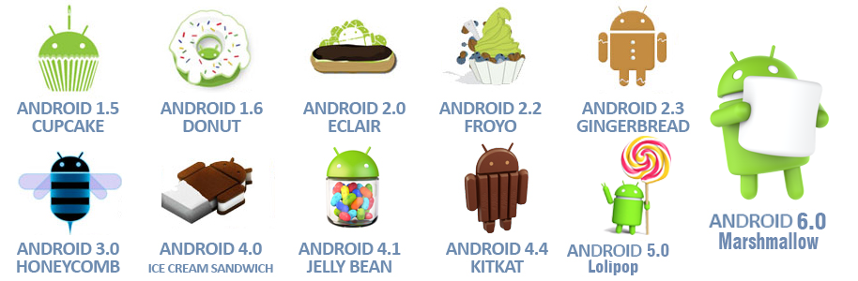
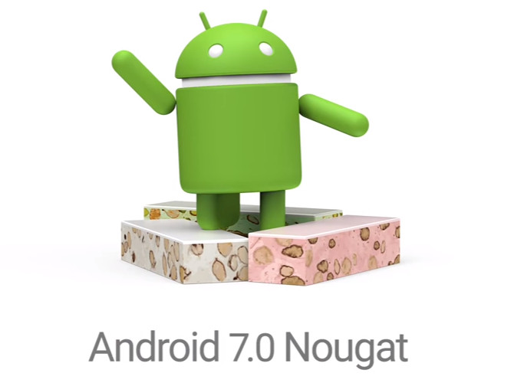

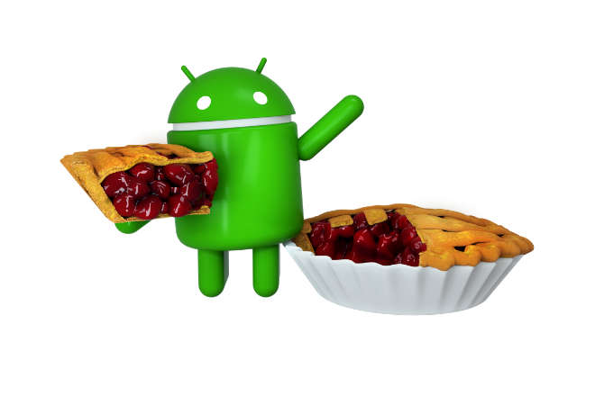
Android Versions
Android has gone through quite a number of updates since its first release

Slide 5
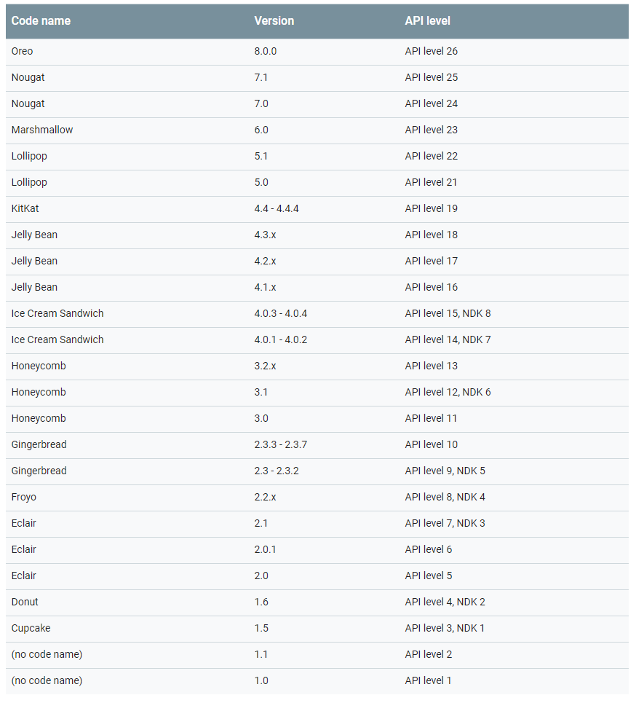
Android Versions

Slide 6
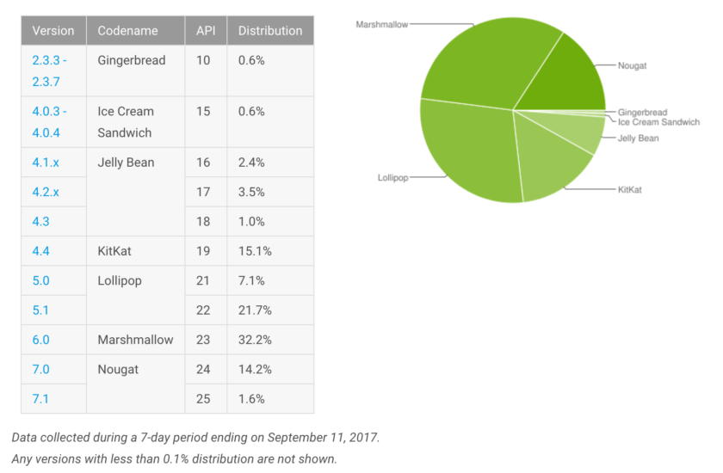
Android Versions

Slide 7
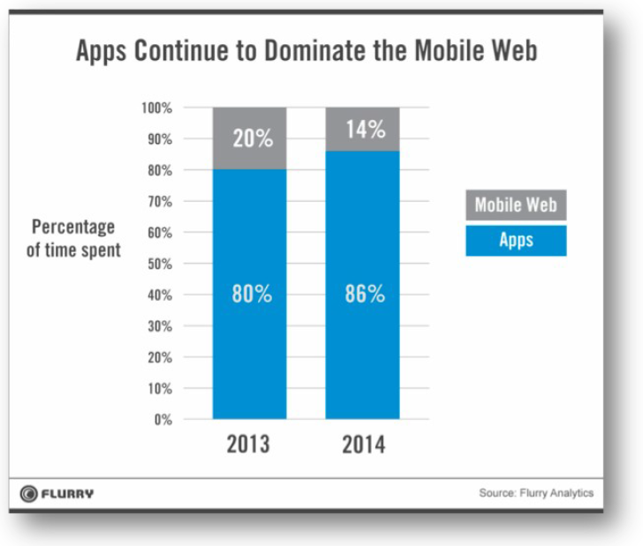
Why develop for Android?
Why not just write a web site? Android has a browser...
better, snappier UI with a more consistent user experience
able to use different kinds of widgets/controls than in a web page
more direct access to the device's hardware (camera, GPS, etc.)
users highly prefer apps over mobile web browsing

Slide 8
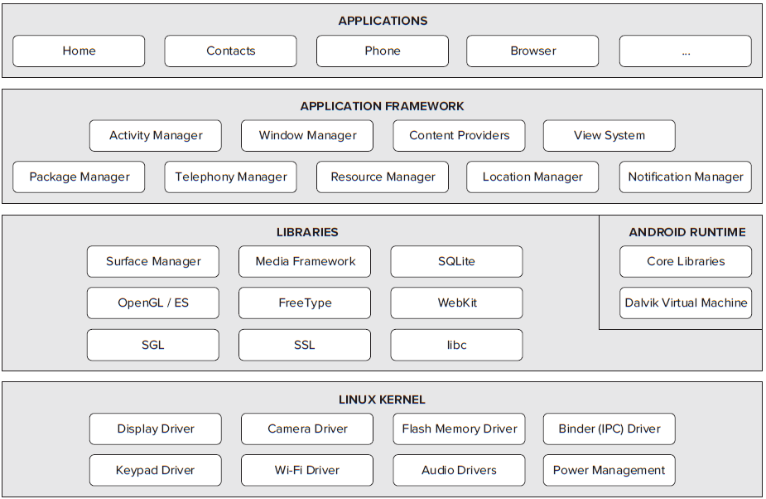
Architecture of Android

Slide 9
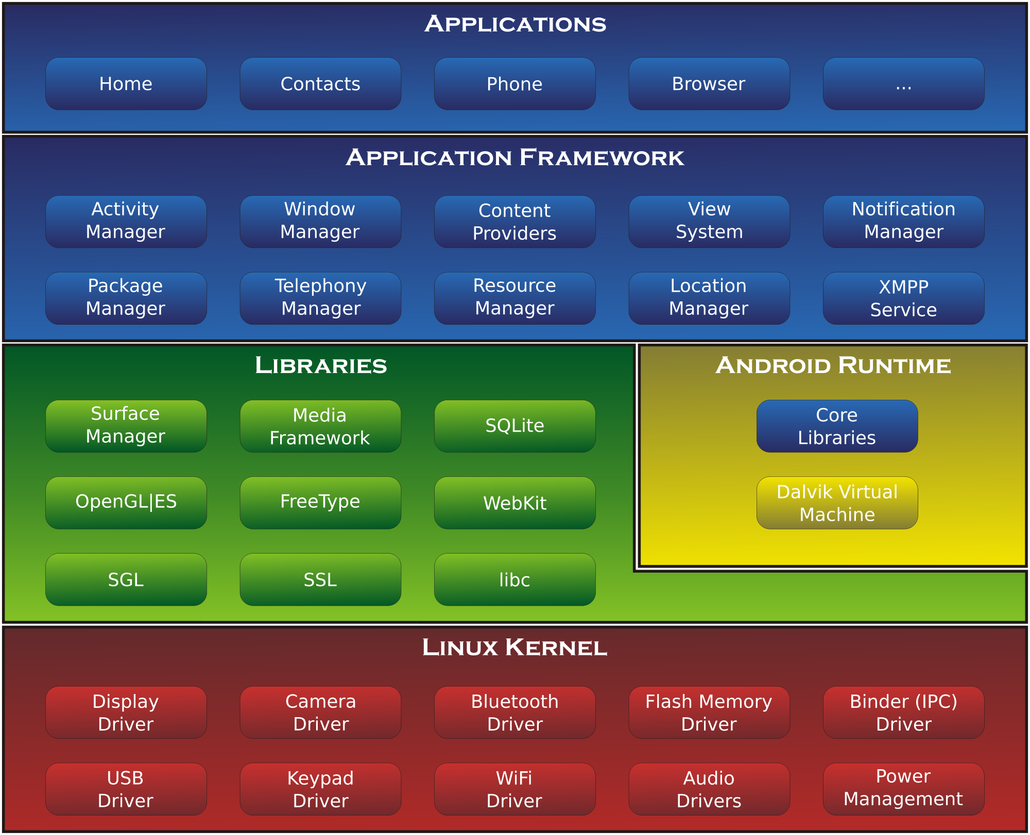
Architecture of Android

Slide 10
Android Platform Architecture

Slide 11
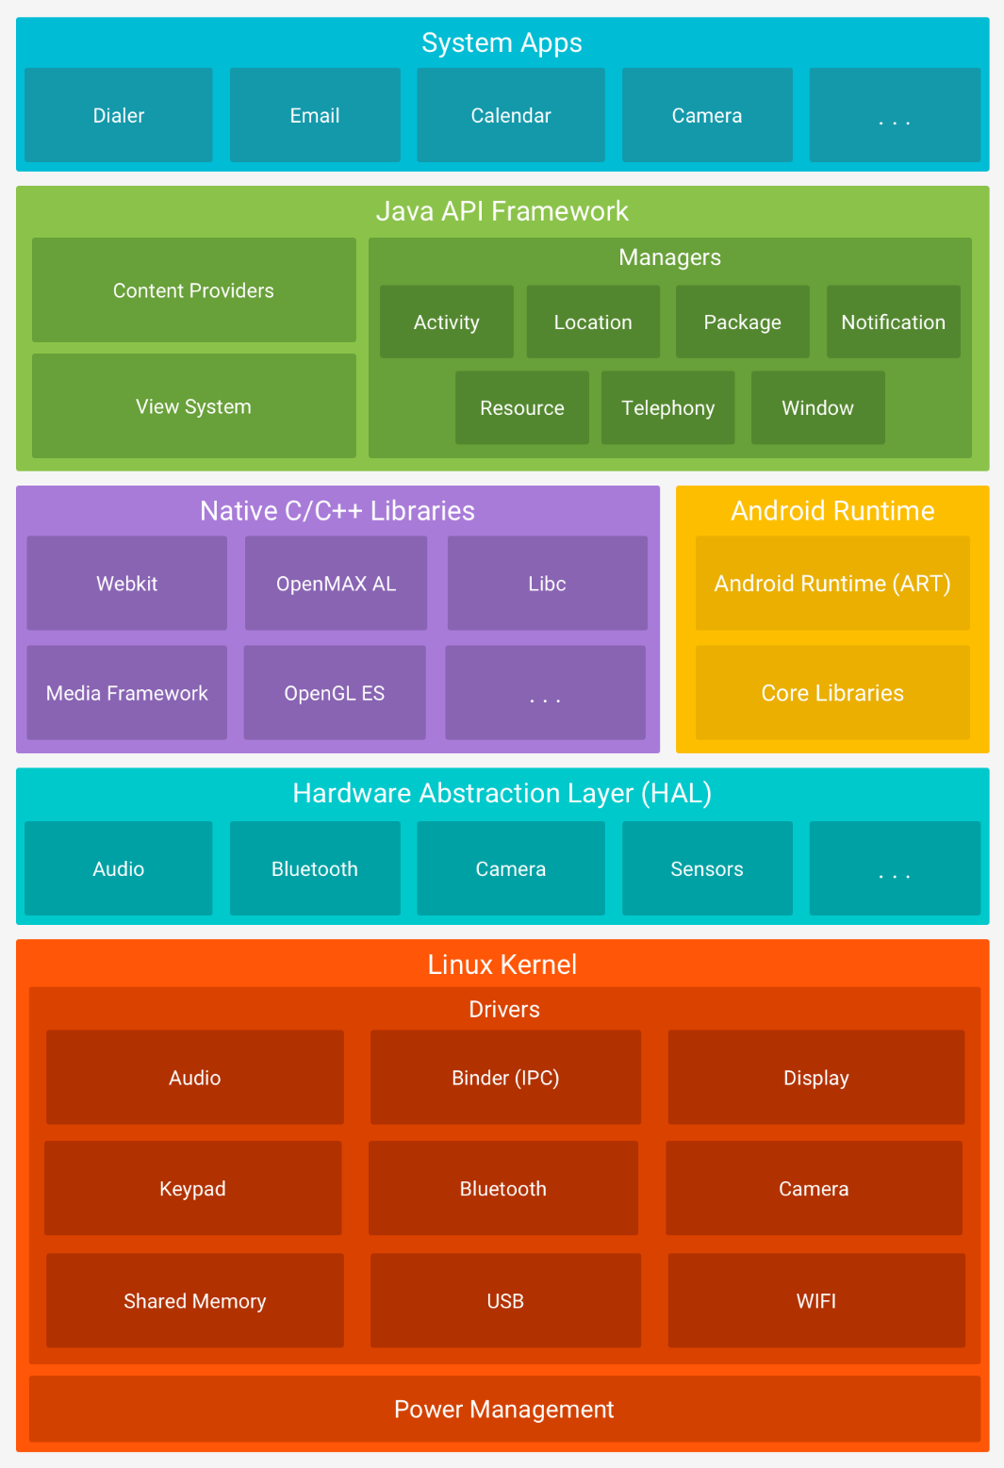

Slide 12
Android Platform Architecture
Linux kernel: This is the kernel on which Android is based. This layer contains all the low-level device drivers for the various hardware components of an Android device.
The Android Runtime (ART) relies on the Linux kernel for underlying functionalities such as threading and low-level memory management

Slide 13
Android Platform Architecture
Hardware Abstraction Layer: provides standard interfaces that expose device hardware capabilities to the higher-level Java API framework.
The HAL consists of multiple library modules, each of which implements an interface for a specific type of hardware component, such as the camera or bluetooth module

Slide 14
Architecture of Android
Android runtime: ART is the next version of Dalvik. Dalvik is the runtime, bytecode, and VM used by the Android system for running Android applications.
ART has two main features compared to Dalvik:
Ahead-of-Time (AOT) compilation, which improves speed (particularly startup time) and reduces memory footprint (no just-in-time (JIT) compilation)
Improved Garbage Collection (GC)
AOT means your apps are compiled to native code once. What is stored on your phone and run is effectively native, not bytecode

Slide 15
Architecture of Android
Native C/C++ Libraries: Many core Android system components and services, such as ART and HAL, are built from native code that require native libraries written in C and C++ (OpenGL API to add support for drawing and manipulating 2D and 3D graphics in your app.)
If you are developing an app that requires C or C++ code, you can use the Android NDK to access some of these native platform libraries directly from your native code.

Slide 16
Architecture of Android
Java API Framework: Exposes the various capabilities of the Android OS to application developers so that they can make use of them in their applications.
System Apps: At this top layer, you will find applications that ship with the Android device (such as Phone, Contacts, Browser, etc.), as well as applications that you download and install from the Android Market.
Any applications that you write are located at this layer.

Slide 17
Android Demo

Slide 18
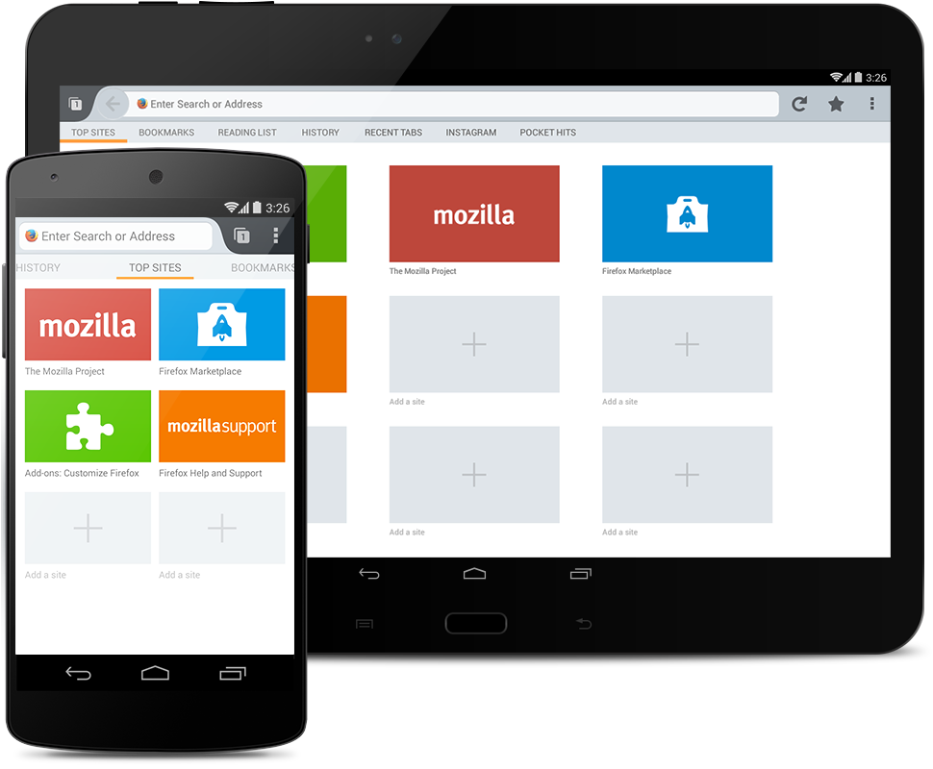
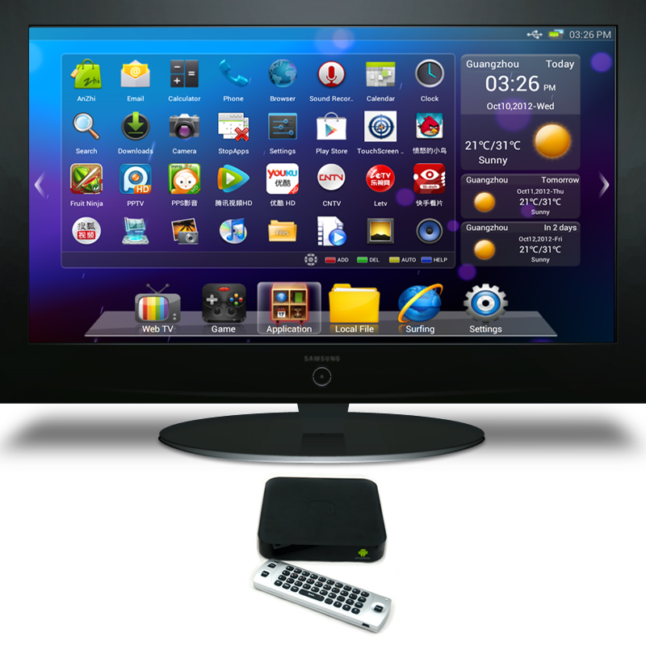
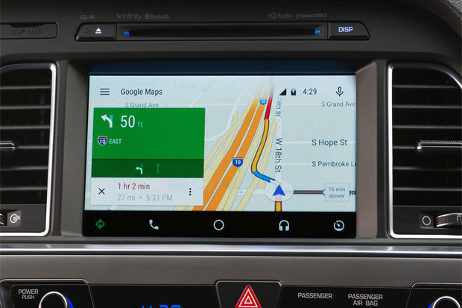
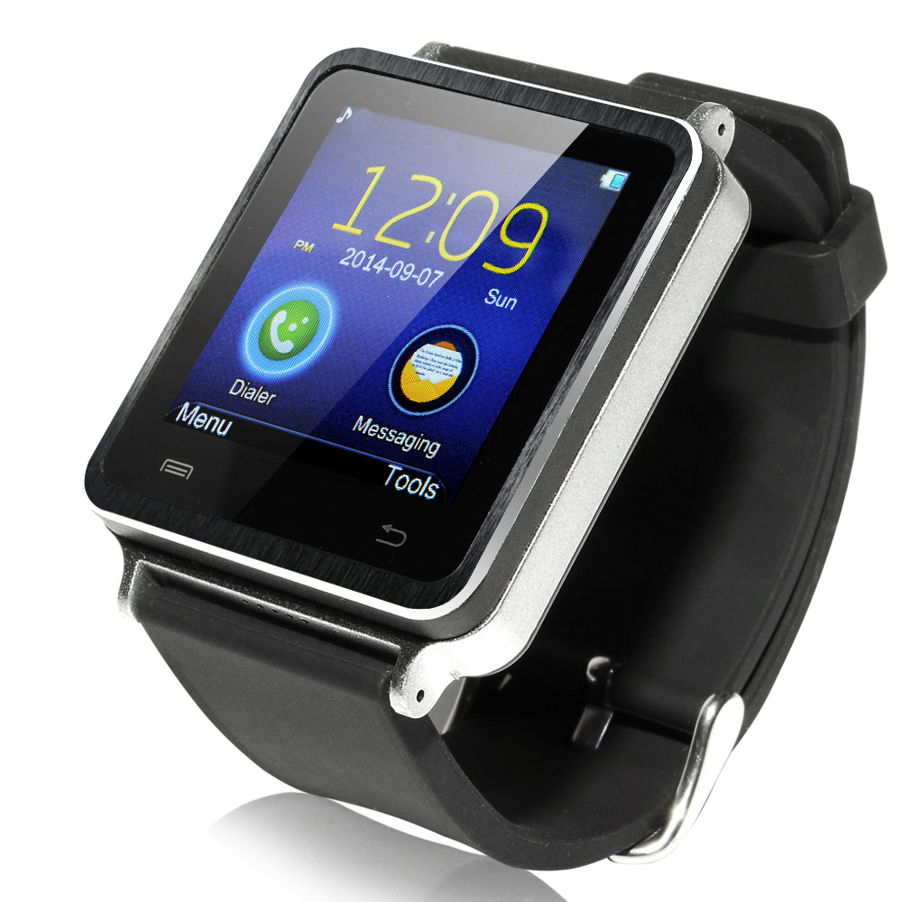
Android Devices

Slide 19
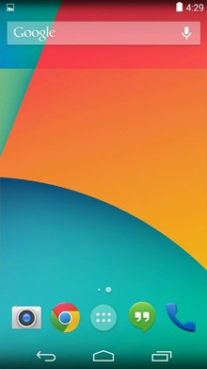
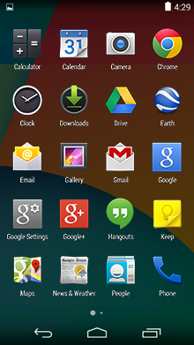
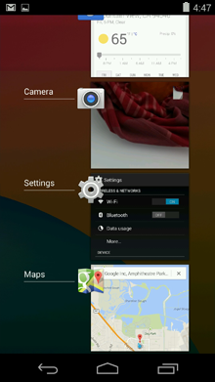
Phones & Tablets
Home, All Apps, and Recent

Slide 20
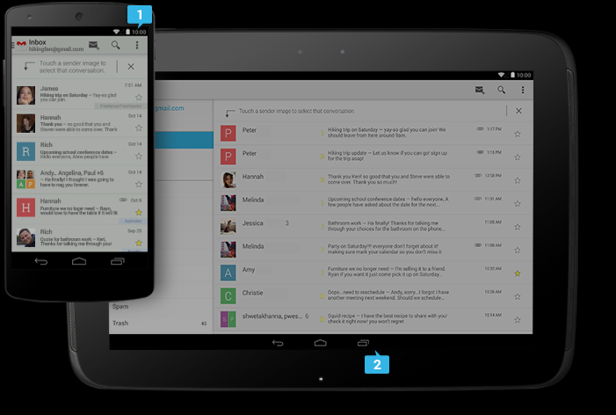
System Bars
Status Bar: Displays pending notifications
Navigation Bar: New for phones in Android 4.0, the navigation bar is present only on devices that don't have the traditional hardware keys. It houses the device navigation controls Back, Home, and Recent.

Slide 21
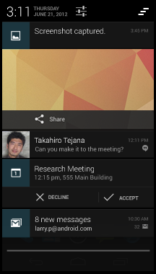
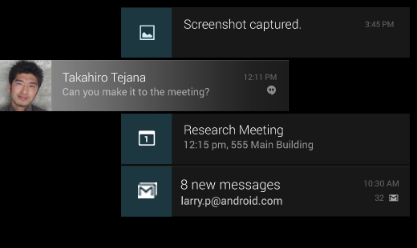
Notifications
Notifications are brief messages that users can access at any time from the status bar

Slide 22
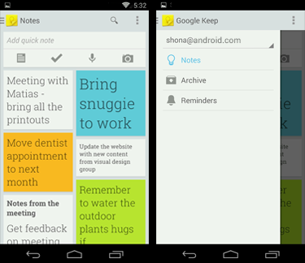
Common App UI
Action Bar: The command and control center for your app.
Navigation Drawer: If your app's structure is more complex, the navigation drawer can display the main navigation options.
Content Area: The space where the content of your app is displayed.

Slide 23
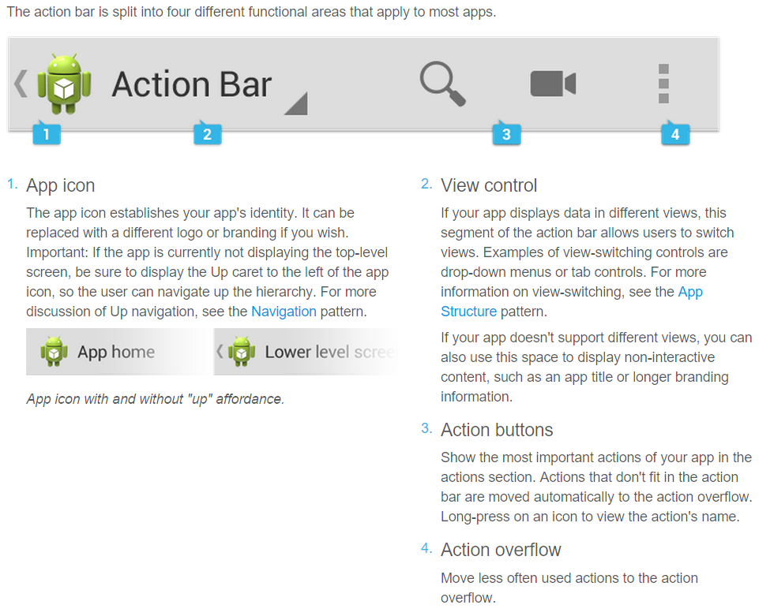
Action Bar

Slide 24
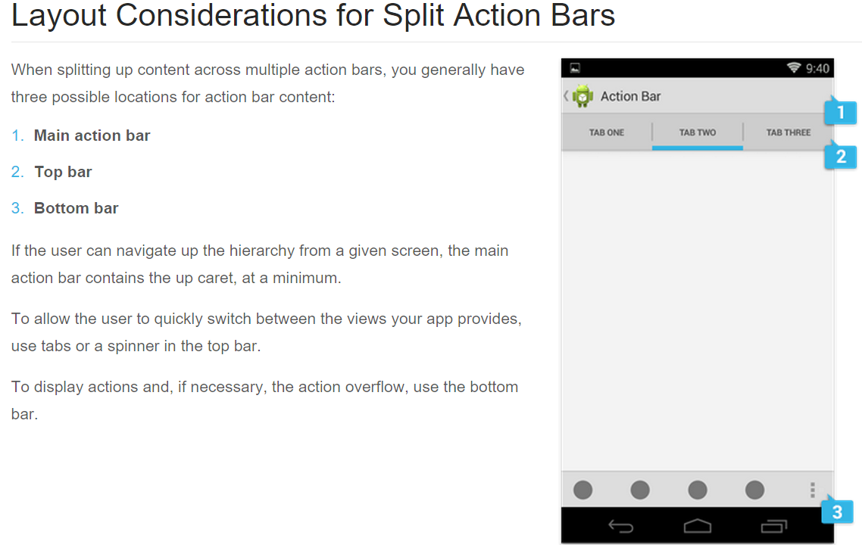
Action Bar

Slide 25
Application Structure
Apps come in many varieties that address very different needs. For example:
Apps such as Calculator or Camera that are built around a single focused activity handled from a single screen
Apps such as Phone whose main purpose is to switch between different activities without deeper navigation
Apps such as Gmail or the Play Store that combine a broad set of data views with deep navigation
Your app's structure depends largely on the content and tasks you want to surface for your users.

Slide 26
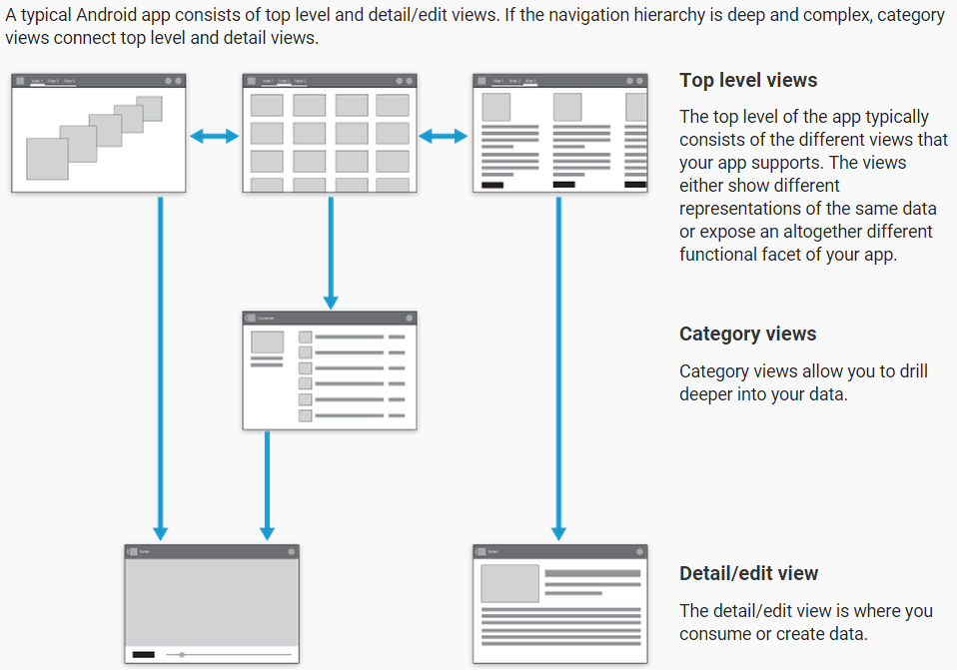
Application Structure

Slide 27
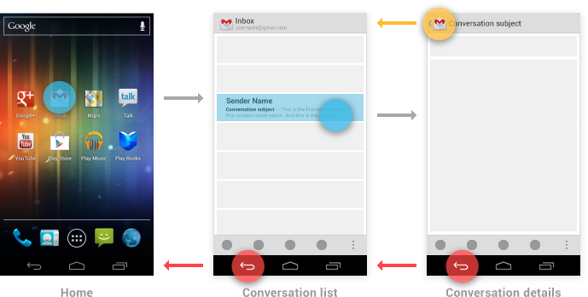
Navigation with Back and Up
The Up button is used to navigate within an app based on the hierarchical relationships between screens.
The system Back button is used to navigate, in reverse order, through the history of screens the user has recently worked with.

Slide 28
Navigation Between Apps
One of the fundamental strengths of the Android system is the ability for apps to activate each other, giving the user the ability to navigate directly from one app into another.

Slide 29
Activities, tasks, and intents
An activity is an application component that defines a screen of information and all of the associated actions the user can perform.
A task is the sequence of activities a user follows to accomplish a goal.
A single task can make use of activities from just one app, or may draw on activities from a number of different apps.
An intent is a mechanism for one app to signal it would like another app's assistance in performing an action.
For common intents such as "Share", the user may have many apps installed that can fulfill that request.

Slide 30
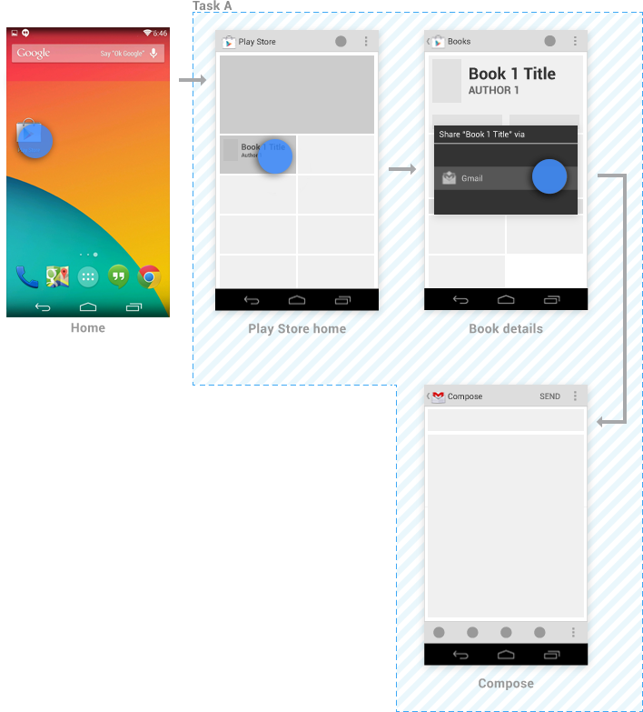
Example: navigating between apps to support sharing

Slide 31
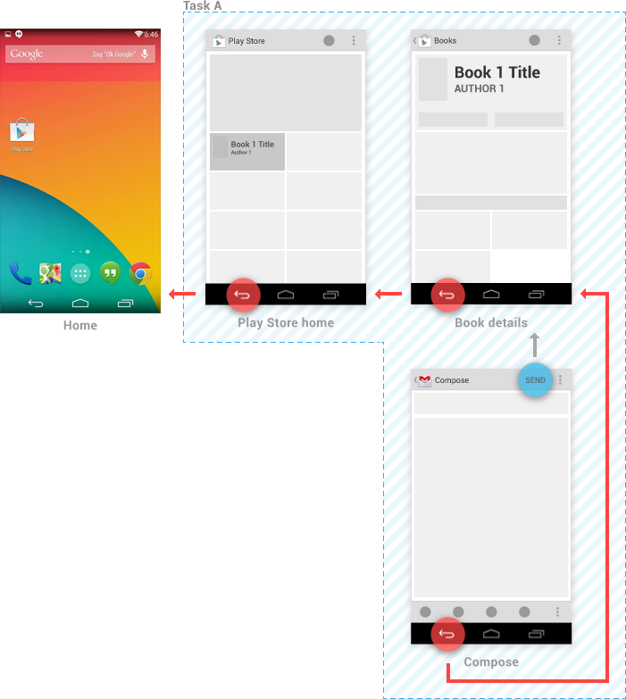
Example: navigating between apps to support sharing

Slide 32
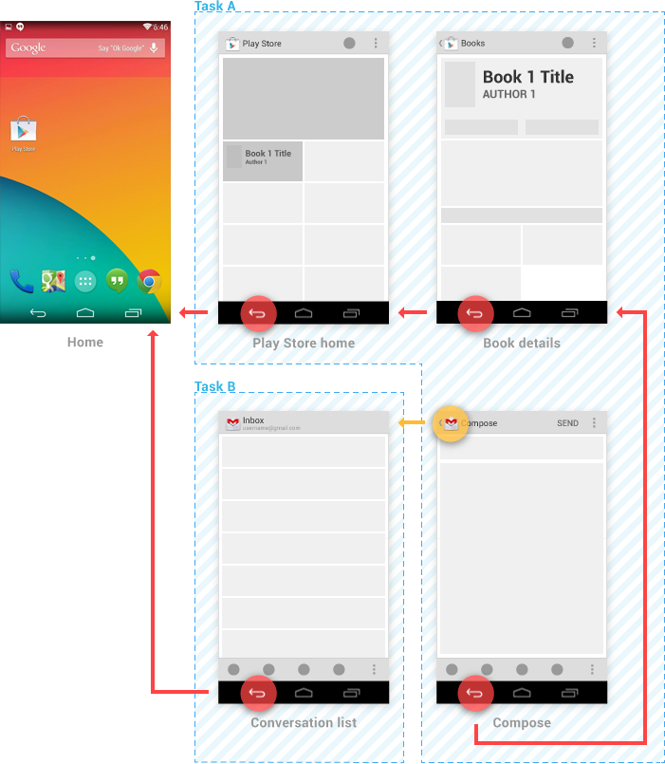
Example: navigating between apps to support sharing

Slide 33
App components
App components are the essential building blocks of an Android app. Each component is an entry point through which the system or a user can enter your app. Some components depend on others.
Activities.
Services.
Broadcast receivers.
Content providers.

Slide 34
Activities
An activity is the entry point for interacting with the user. It represents a single screen with a user interface. For example, an email app might have one activity that shows a list of new emails, another activity to compose an email, and another activity for reading emails

Slide 35
Services
A service is a general-purpose entry point for keeping an app running in the background for all kinds of reasons. It is a component that runs in the background to perform long-running operations or to perform work for remote processes.
A service does not provide a user interface.
For example, a service might play music in the background while the user is in a different app, or it might fetch data over the network without blocking user interaction with an activity

Slide 36
Broadcast receivers
A broadcast receiver is a component that enables the system to deliver events to the app outside of a regular user flow, allowing the app to respond to system-wide broadcast announcements.
The system can deliver broadcasts even to apps that aren't currently running. So, for example, an app can schedule an alarm to post a notification to tell the user about an upcoming event... and by delivering that alarm to a BroadcastReceiver of the app, there is no need for the app to remain running until the alarm goes off.
Many broadcasts originate from the system—for example, a broadcast announcing that the screen has turned off, the battery is low, or a picture was captured.

Slide 37
Content providers
A content provider manages a shared set of app data that you can store in the file system, in a SQLite database, on the web, or on any other persistent storage location that your app can access.
Through the content provider, other apps can query or modify the data if the content provider allows it.
For example, the Android system provides a content provider that manages the user's contact information. As such, any app with the proper permissions can query the content provider, such as ContactsContract.Data, to read and write information about a particular person

Slide 38
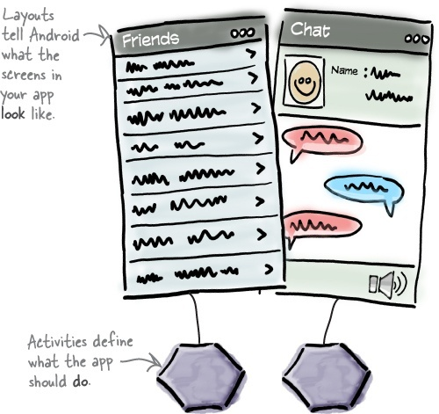
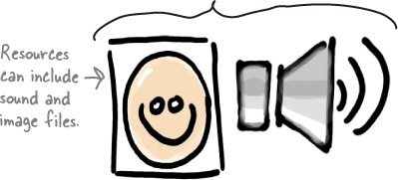
What makes up a typical Android app?
Layouts define what each screen looks like
Layouts are usually defined using XML
Java code defines what the app should do
A special Java class called an activity decides which layout to use and tells the app how to respond to the user
Sometimes extra resources are needed too

Slide 39
Creating a basic Android app
Set up a development environment.
We need to install Android Studio, which includes all the tools you need to develop your Android apps.
Build a basic app.
We’ll build a simple app using Android Studio that will display some sample text on the screen.
Run the app in the Android emulator.
We’ll use the built-in emulator to see the app up and running
Change the app.
Finally, we’ll make a few tweaks to the app we created in step 2, and run it again.

Slide 40
Development Environment
Android devices don’t run .class and .jar files. Instead Android devices use their own optimized formats for compiled code.
That means that you can’t use an ordinary Java development environment—you also need special tools to convert your compiled code into an Android format.

Slide 41
Development Environment
Dalvik is a process virtual machine (VM) in Google's Android operating system that executes applications written for Android.
This makes Dalvik an integral part of the Android software stack (in Android versions 4.4 "KitKat" and earlier)
Programs are commonly written in Java and compiled to bytecode for the Java virtual machine, which is then translated to Dalvik bytecode and stored in .dex (Dalvik EXecutable)
An alternative runtime environment called Android Runtime (ART) was included in Android 4.4 "KitKat" as a technology preview.
ART replaces Dalvik entirely in Android 5.0 "Lollipop".
Notes:
Benefits of ART
Reduces startup time of applications as native code is directly executed.
Improves battery performance as power utilized to interprete byte codes line by line is saved.
As JIT is not in the picture no on the fly compilation and native code storage. This significantly reduces memory footprint (less RAM is required for application to run).
Drawbacks of ART
As dex bytecodes are converted to native machine code on installation itself, installation takes more time.
As the native machine code generated on installation is stored in internal storage, more internal storage is required.

Slide 42
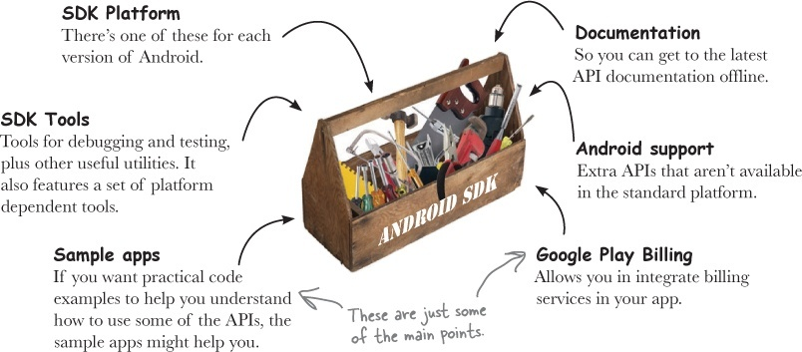
The Android SDK

Slide 43
Android Studio
Install Java
http://www.oracle.com/technetwork/java/javase/downloads/index.html
Then install Android Studio
https://developer.android.com/sdk/index.html

Slide 44
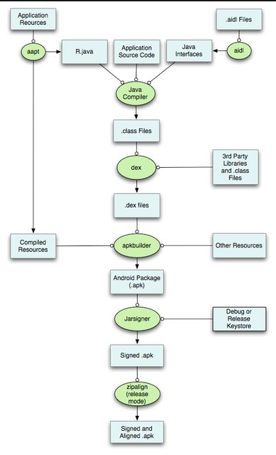

Slide 45
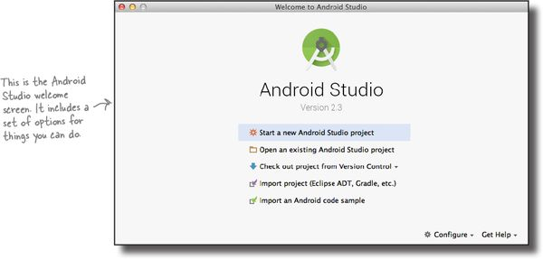

Slide 46
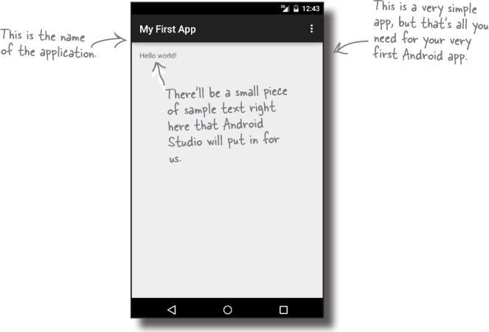
Build a basic app

Slide 47
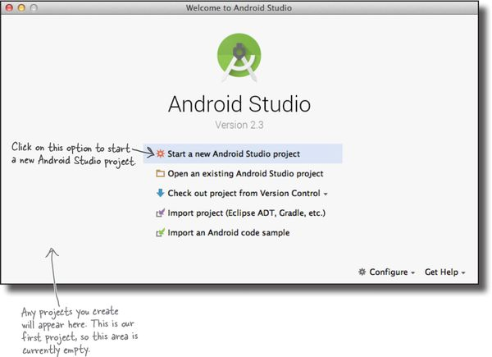
1. Create a new project

Slide 48
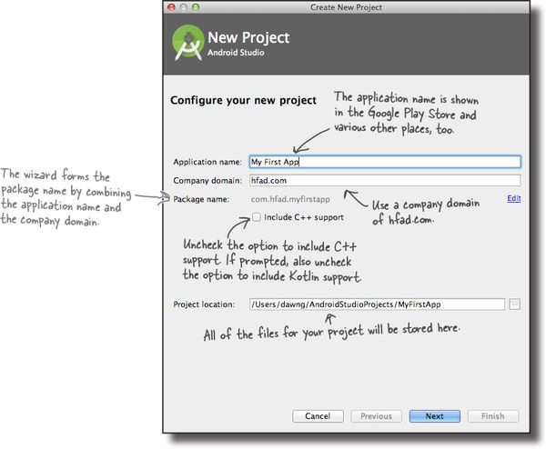
2. Configure the project

Slide 49
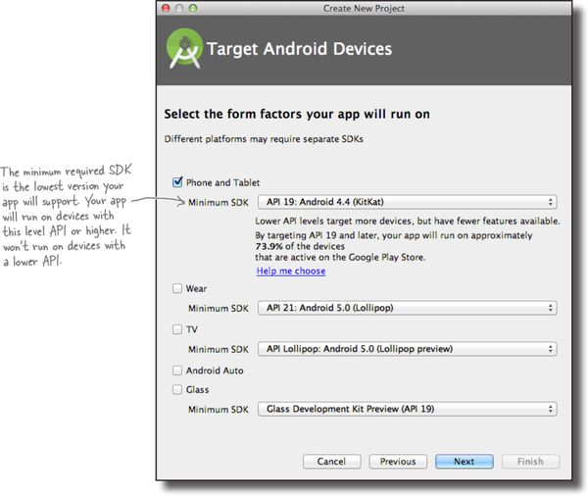
3. Specify the API level

Slide 50
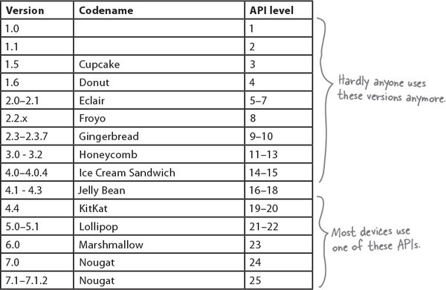
3. Specify the API level

Slide 51
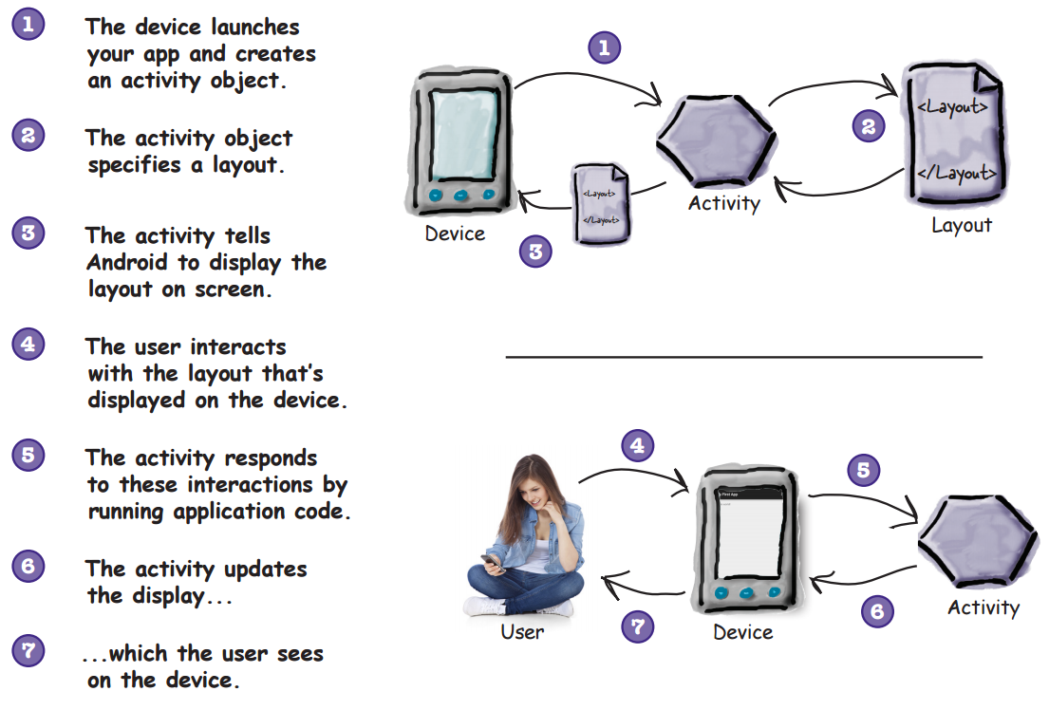
4. Create an activity

Slide 52
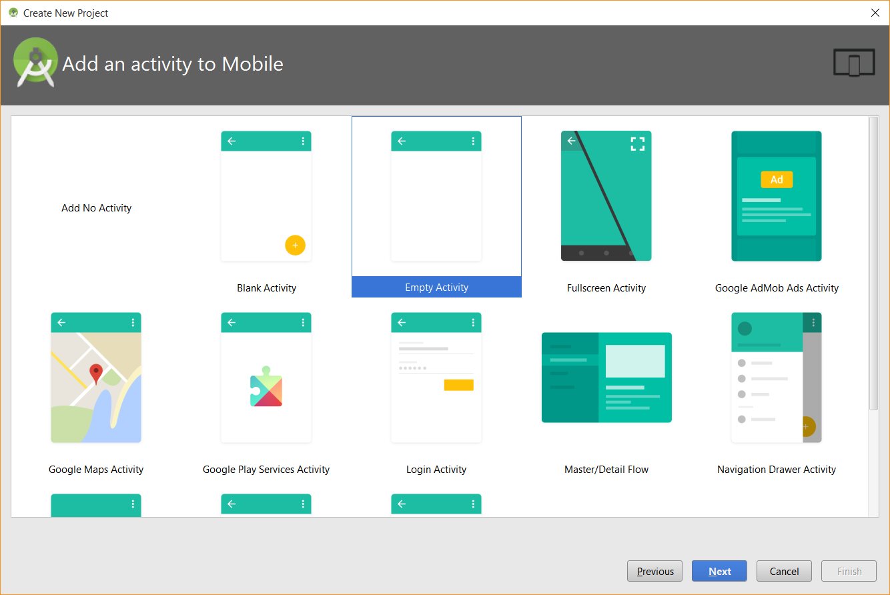
4. Create an activity

Slide 53
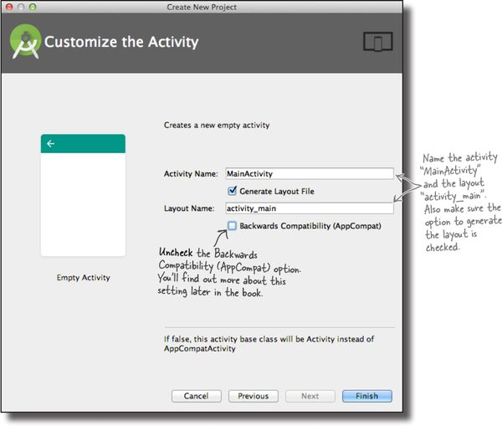
5. Configure the activity

Slide 54
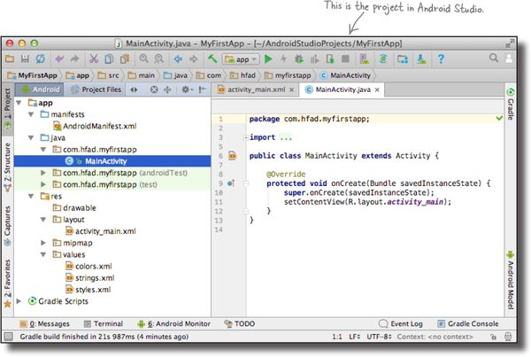
First Android app

Slide 55
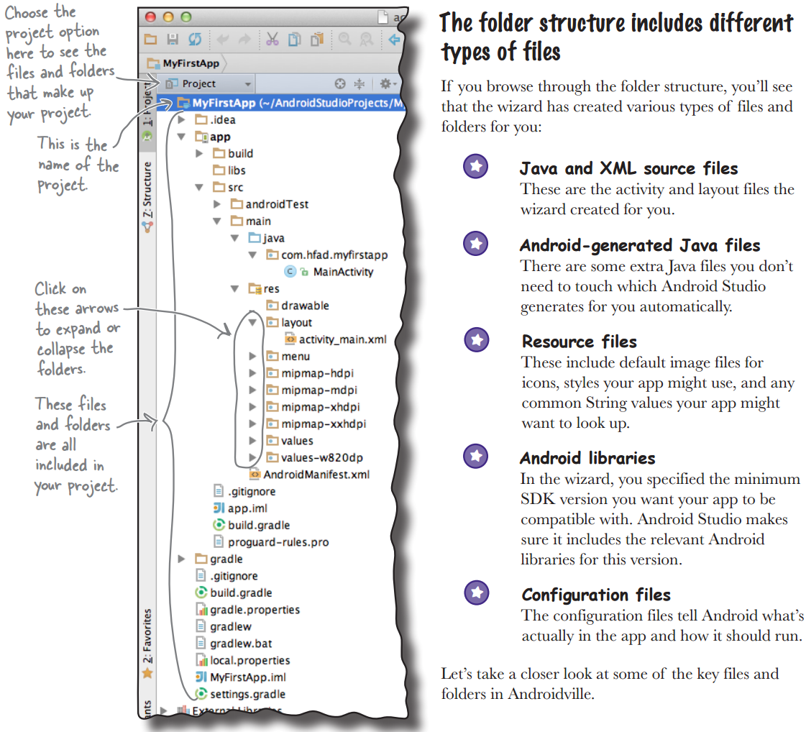

Slide 56
Gradle projects standard layout
Gradle is the official build system for Android Studio
https://gradle.org
Android Studio projects use the gradle build system to compile and deploy your apps.
Gradle projects have a standard layout.
Here are some of the key files and folders you’ll be working with

Slide 57
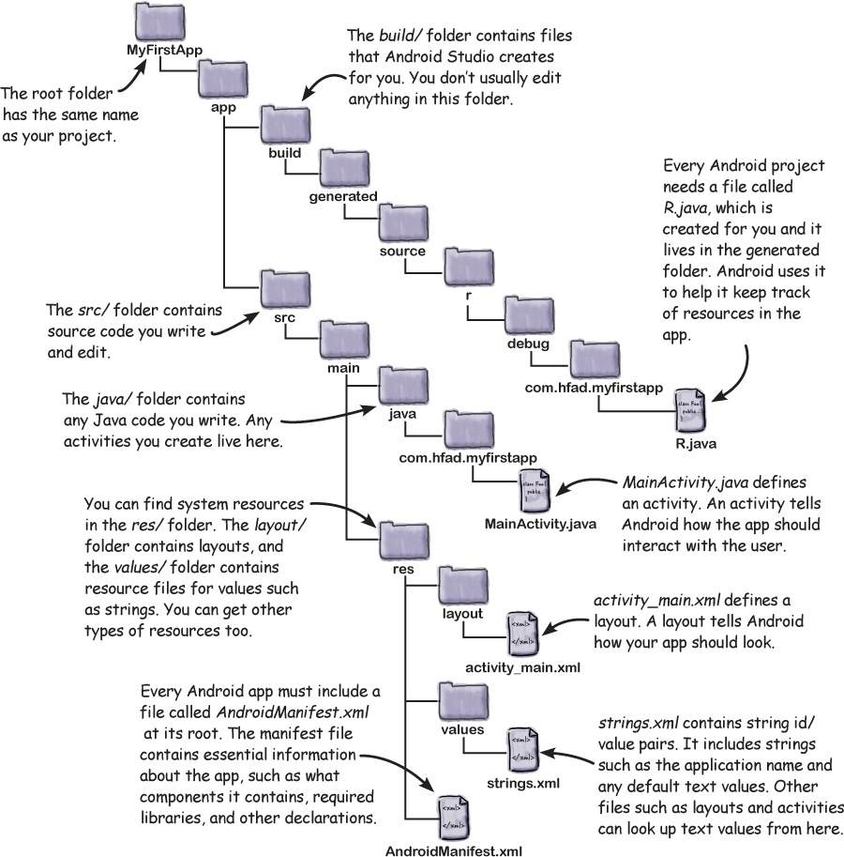

Slide 58
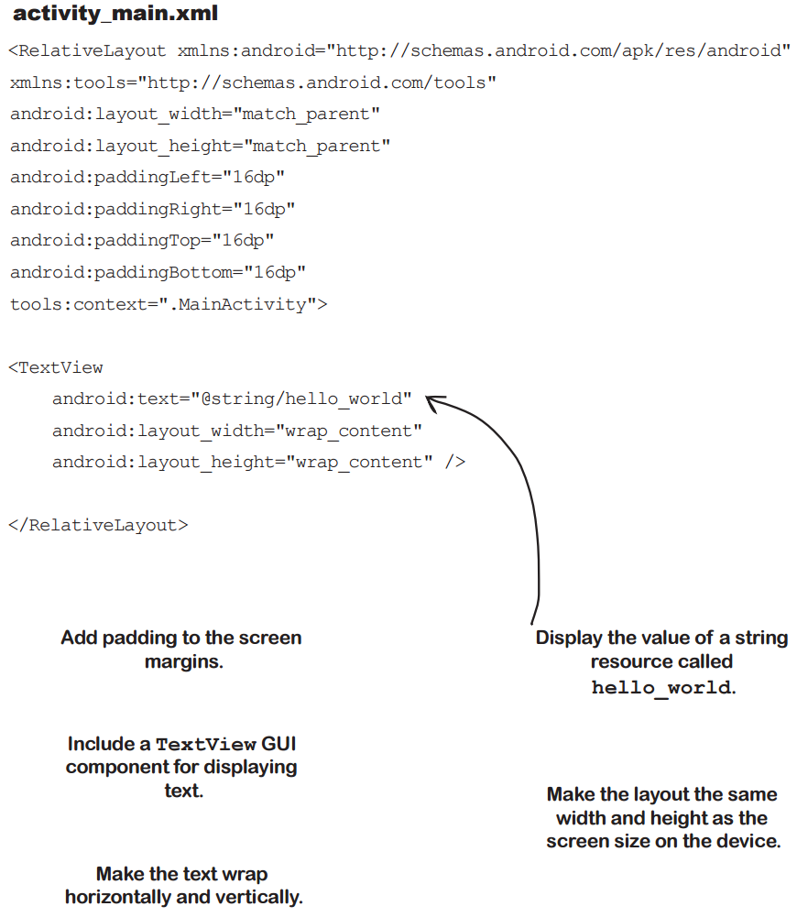

Slide 59
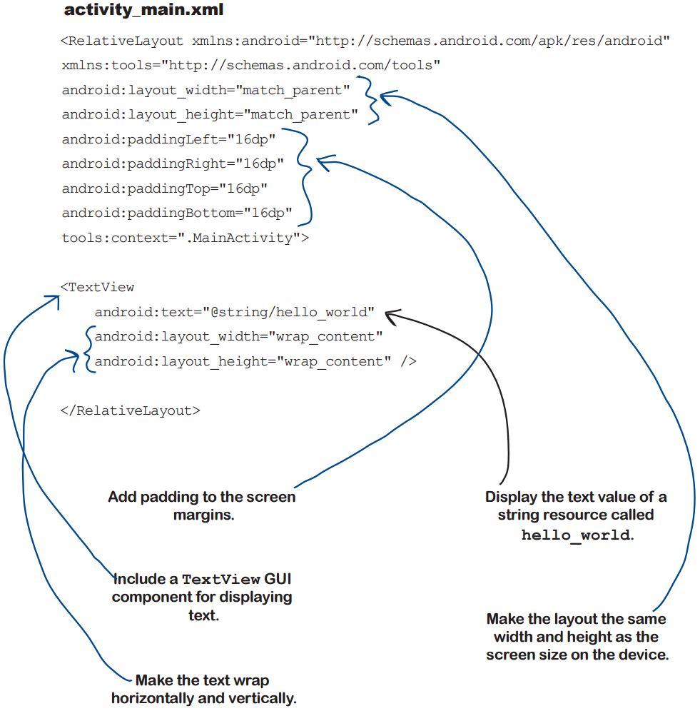

Slide 60
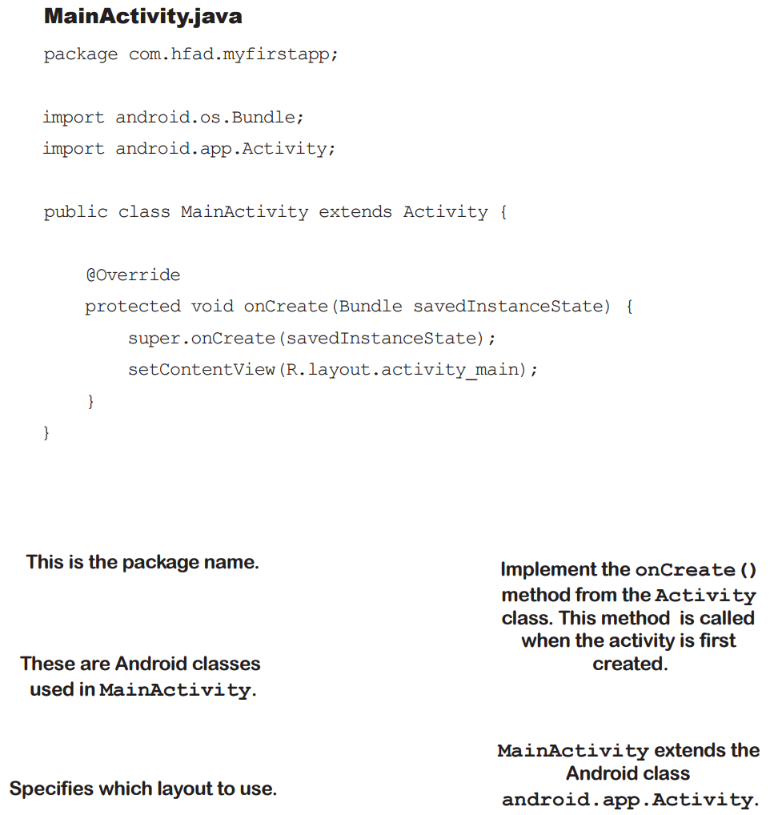

Slide 61
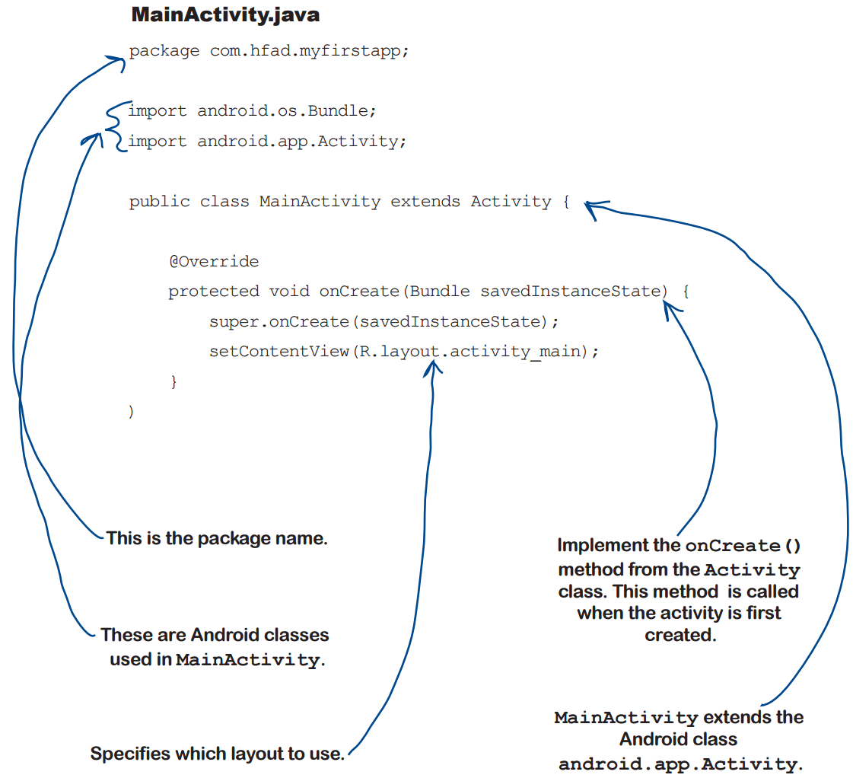

Slide 62
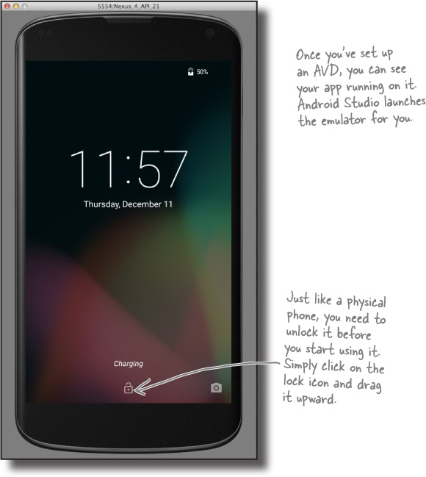
Run the app in the Android emulator
The Android emulator allows you to run your app on an Android virtual device (AVD).
The AVD behaves just like a physical Android device.
You can set up numerous AVDs, each emulating a different type of device.

Slide 63
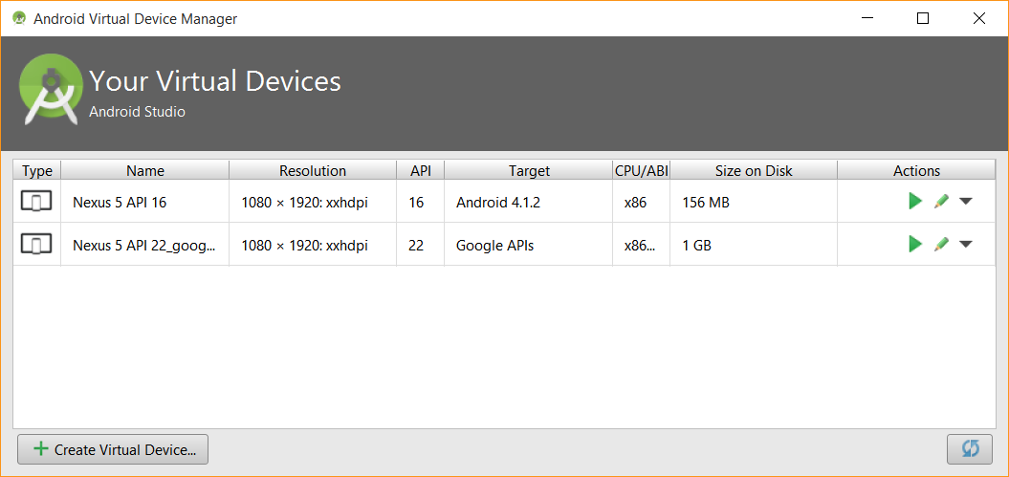
Creating an Android Virtual Device

Slide 64
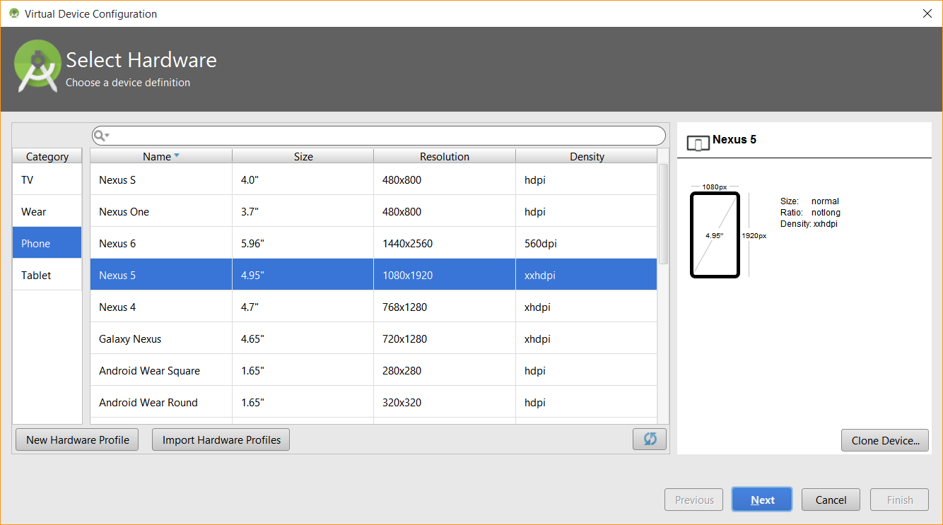
Select the hardware

Slide 65

Select a system image

Slide 66


Slide 67

Run the app in the emulator

Slide 68

Test drive

Slide 69
Next Lecture
Chapter 2: Building Interactive Apps

